Slide 1

Optimization Problems in Public Transport Networks and their Underlying Graphs
Balázs Dávid
WGT-Workshop on Graph Theory and Its Applications-XII,
24.10.2025

Slide 2

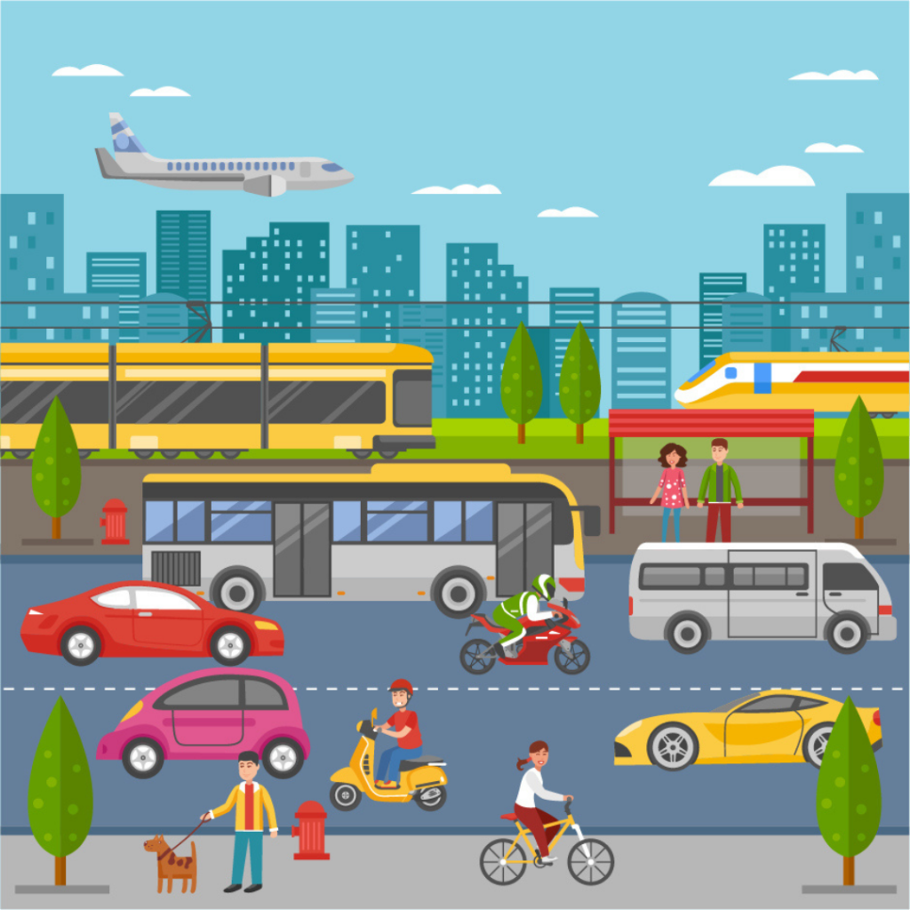
Modalities of transportation
source: https://iudx.org.in/sustainable-and-equitable-urban-transport-with-iudx/

Slide 3
Modalities of transportation
Goal is the same for all modalities
Planning stages are also similar
HOWEVER
Capacities
Infrastructure
Trip characteristics
…

Slide 4
Public (bus) transportation
Traveling by bus (or any other vehicle)
Timetables given by the company
Bus-stops between two end-stations
„Behind the scenes”
Daily vehicle schedules
Made up of vehicle blocks
Block: a sequence of tasks carried out by a single vehicle
Driver shifts
Driver assignments

Slide 5
Hierarchical breakdown of planning process stages
Line planning
Timetabling
Vehicle scheduling
Driver scheduling
Driver rostering

Slide 6
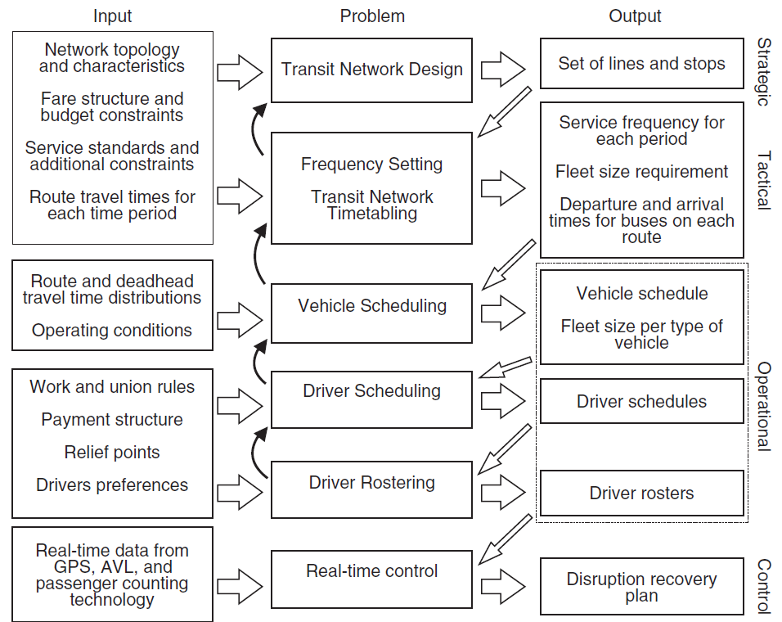
Hierarchical breakdown of planning process stages
Ibarra-Rojas, O. J., Delgado, F., Giesen, R., & Muñoz, J. C. (2015). Planning, operation, and control of bus transport systems: A literature review. Transportation Research Part B: Methodological, 77, 38–75. https://doi.org/10.1016/j.trb.2015.03.002

Slide 7
Hierarchical breakdown of planning process stages
Vehicle scheduling
Identify sets of compatible tasks carried out by single vehicles during a day
Vehicle block
Mostly travel activities
Driver scheduling
Identify sets of compatible tasks carried out by single drivers during a day
Driver duty/shift
No 1-to-1 correspondence to vehicle blocks
Driver rostering
Assign daily duties to actual employees over a planning horizon
Employee roster

Slide 8
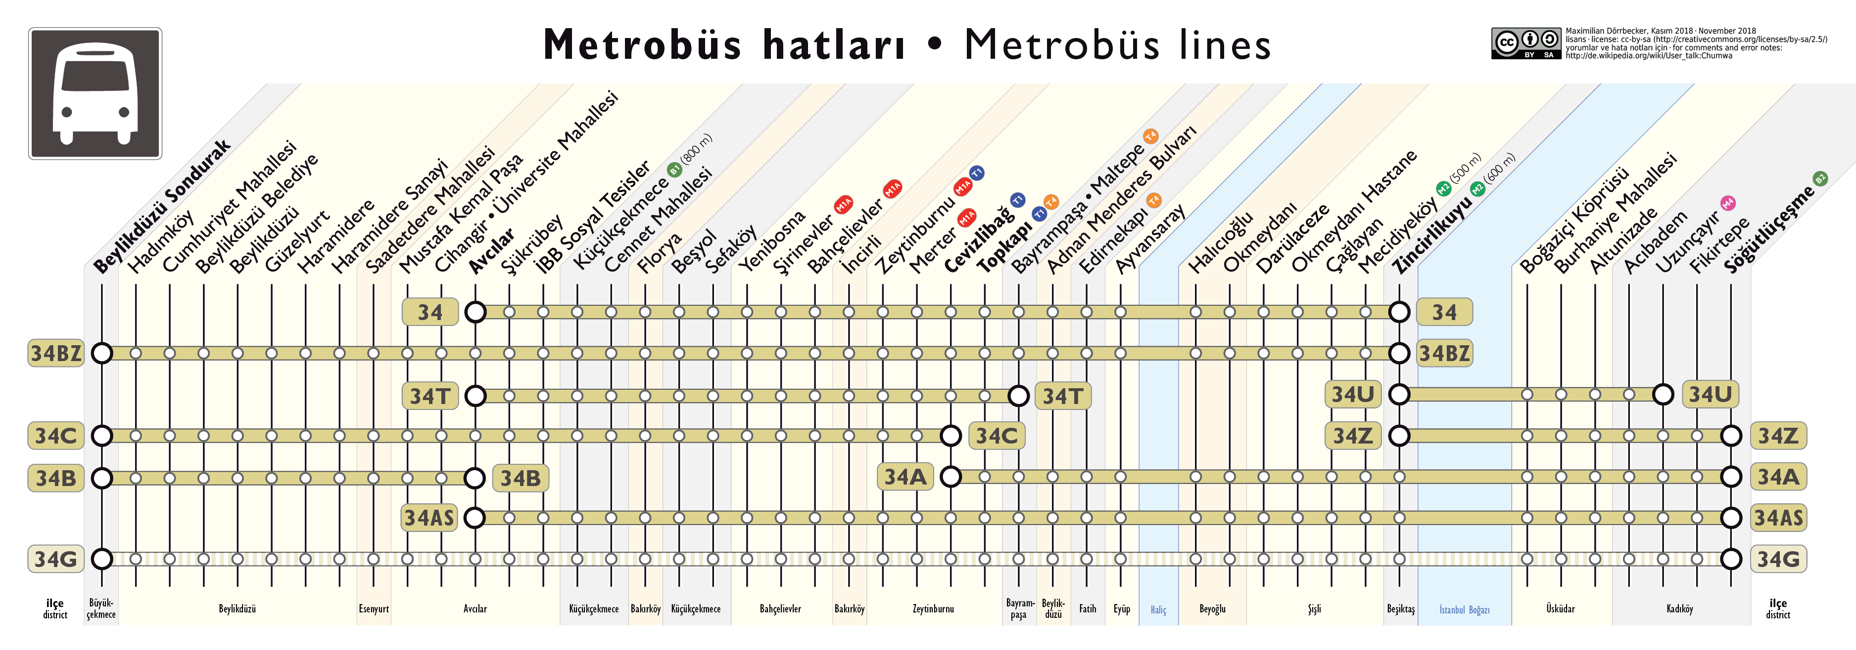
Line planning
source: https://upload.wikimedia.org/wikipedia/commons/e/e2/Istanbul_Metrob%C3%BCs_Lines.png

Slide 9
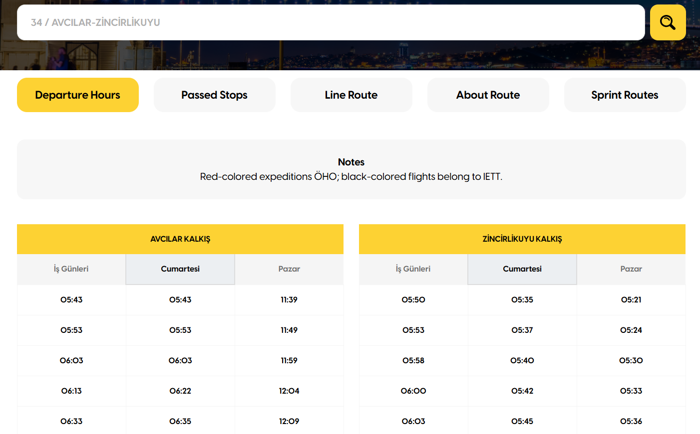
Timetabling

Slide 10
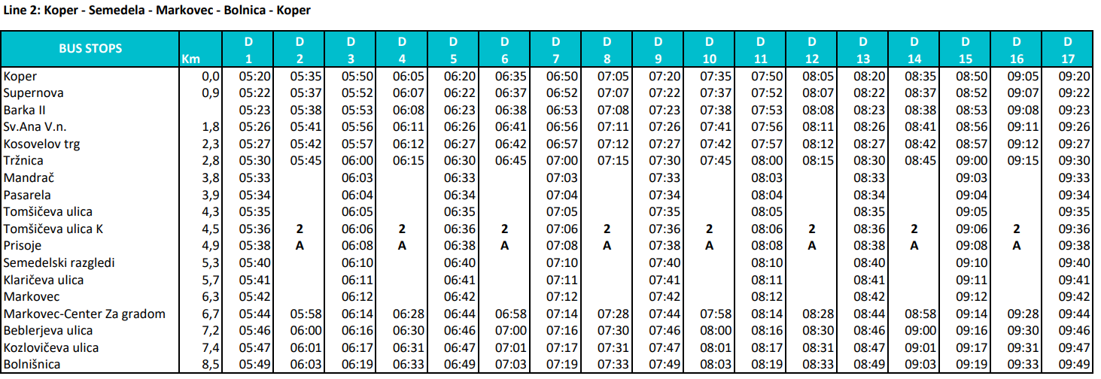
Timetabling
Starting location
Departure time
Ending location
Arrival time
Trip (vehicle journey)

Slide 11
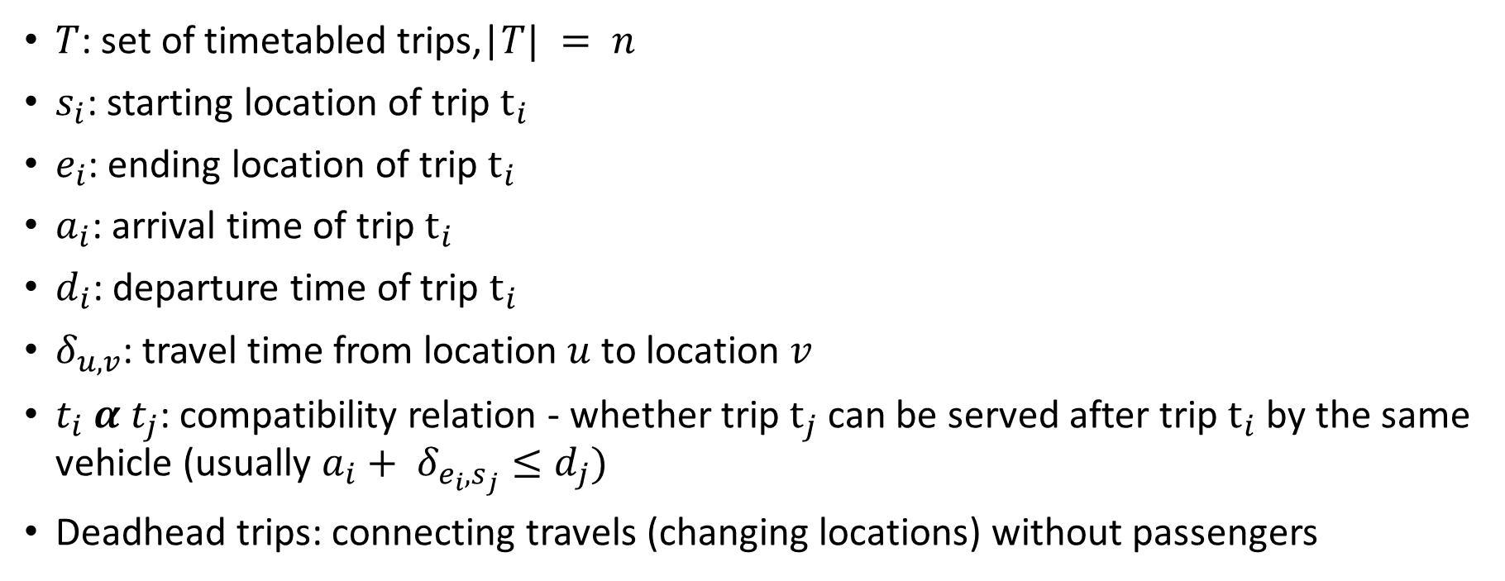
Vehicle scheduling (VSP)
$T$: set of timetabled trips,|
: starting location of trip $t_{i}$
$e_{i}$: ending location of trip $t_{i}$
$a_{i}$: arrival time of trip $t_{i}$
$d_{i}$: departure time of trip $t_{i}$
$δ_{u,v}$: travel time from location $u$ to location $v$
$t_{i} α t_{j}$: compatibility relation - whether trip $t_{j}$ can be served after trip $t_{i}$ by the same vehicle (usually $a_{i}+ δ_{e_{i},s_{j}}≤d_{j})$
Deadhead trips: connecting travels (changing locations) without passengers

Slide 12
Vehicle scheduling (VSP)
Vehicle scheduling problem (VSP): assign trips to a fleet of vehicles, so that:
Each trip is assigned to exactly one vehicle
Trips assigned to a given vehicle are pairwise compatible
A given set of other constraints are satisfied
A cost function is minimized

Slide 13

An example for the VSP
time
G1
a
G2
G1
b
G1
G1
d
G2
G2
f
G2
G2
c
G1
G1
e
G1

Slide 14

VSP – Matching
Bipartite graph $N = (S,T,A)$
$S = T = n$
$i∈S$: ending event of trip $t_{i}$
$j∈T$: starting event of trip $t_{j}$
$A = \left\{\left(i,j\right) \right| t_{i} α t_{j}\}$: ending location of $t_{i}$ is the same as the starting location of $t_{j}$
Saha, J. L. (1970). An algorithm for bus scheduling problems. Operational Research Quarterly, 21(4), 463–474. https://doi.org/10.2307/3008423

Slide 15
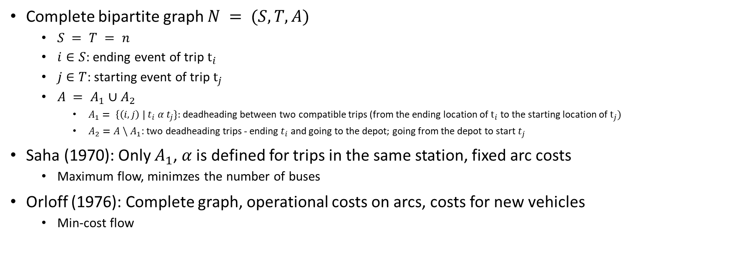
VSP – Matching
Complete bipartite graph $N = (S,T,A)$
$S = T = n$
$i∈S$: ending event of trip $t_{i}$
$j∈T$: starting event of trip $t_{j}$
$A = A_{1}∪A_{2}$
$A_{1}= \left\{\left(i,j\right) \right| t_{i} α t_{j}\}$: deadheading between two compatible trips (from the ending location of $t_{i}$ to the starting location of $t_{j})$
$A_{2}=A \backslash A_{1}$: two deadheading trips - ending $t_{i}$ and going to the depot; going from the depot to start $t_{j}$
Saha (1970): Only $A_{1}$, $α$ is defined for trips in the same station, fixed arc costs
Maximum flow, minimzes the number of buses
Orloff (1976): Complete graph, operational costs on arcs, costs for new vehicles
Min-cost flow
Saha, J. L. (1970). An algorithm for bus scheduling problems. Operational Research Quarterly, 21(4), 463–474. https://doi.org/10.2307/3008423
Orloff, C. S. (1976). Route constrained fleet scheduling. Transportation Science, 10(2), 149–168. https://doi.org/10.1287/trsc.10.2.149
Bertossi, A. A., Carraresi, P., & Gallo, G. (1987). On some matching problems arising in vehicle scheduling models. Networks, 17(3), 271–281. https://doi.org/10.1002/net.3230170303

Slide 16




VSP – Matching
time
G1
a
G2
G1
b
G1
G1
d
G2
G2
f
G2
c
e
$$A_{1}$$
G2
G1
G1
G1
$$S$$
$$T$$
$$A_{2}$$
(and all other missing arcs)
G1
a
G2
G1
a
G2
G1
b
G1
G1
b
G1
G2
c
G1
G2
c
G1
G1
d
G2
G1
d
G2
G1
e
G1
G1
e
G1
G2
f
G2
G2
f
G2

Slide 17
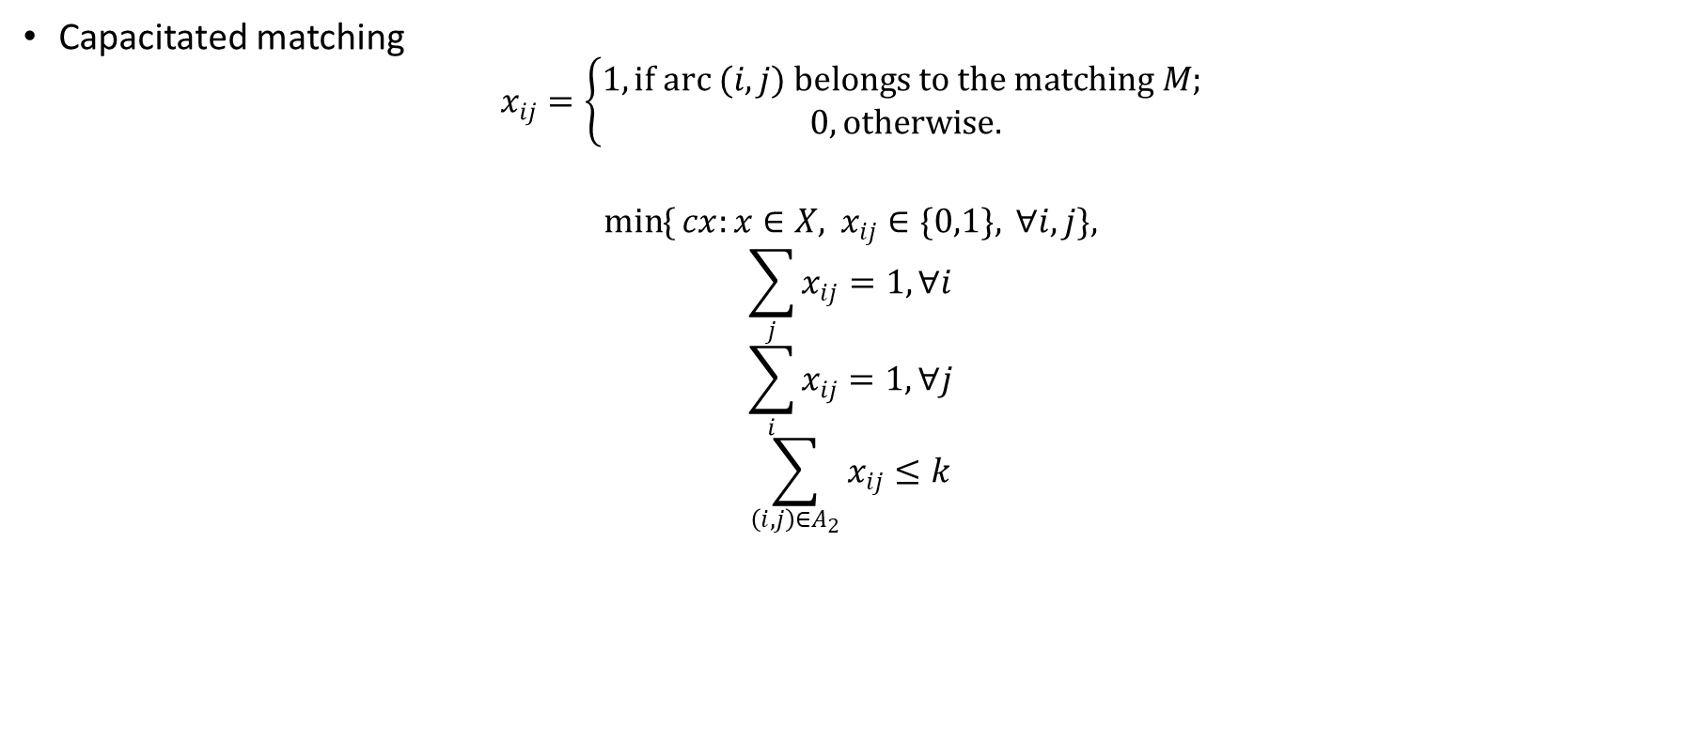
VSP – Matching
Capacitated matching
$$x_{ij}=\left\{\begin{aligned}1, if arc (i,j) belongs to the matching M; \\ 0, otherwise.\end{aligned}\right.$$
$$\min{\{}cx:x∈X, x_{ij}∈\{0,1\}, ∀i,j\},$$
$$\sum_{j}{x_{ij}}=1,∀i$$
$$\sum_{i}{x_{ij}}=1,∀j$$
$$\sum_{\left(i,j\right)∈A_{2}}{x_{ij}}≤k$$
Bertossi, A. A., Carraresi, P., & Gallo, G. (1987). On some matching problems arising in vehicle scheduling models. Networks, 17(3), 271–281. https://doi.org/10.1002/net.3230170303

Slide 18
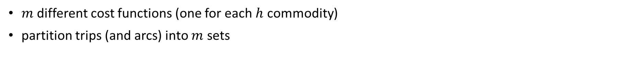
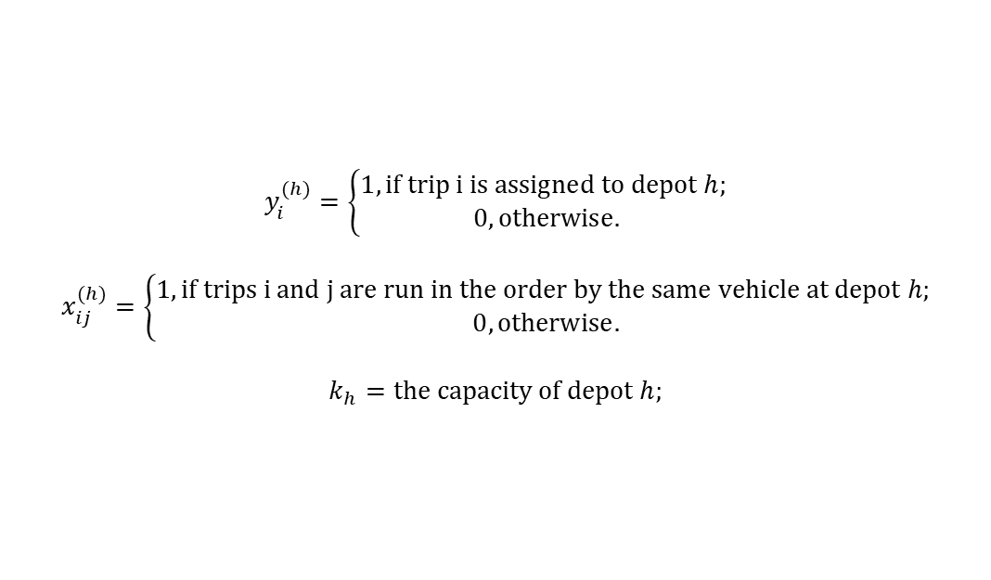
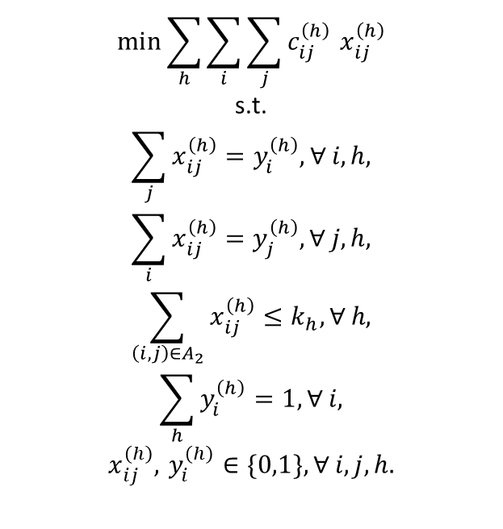
VSP – Multicommodity Matching
$m$ different cost functions (one for each $h$ commodity)
partition trips (and arcs) into $m$ sets
$$\min{\sum_{h}{\sum_{i}{\sum_{j}{c_{ij}^{\left(h\right)}}}}} x_{ij}^{\left(h\right)}$$
$$\text{s}\text{.}\text{t}\text{.}$$
$$\sum_{j}{x_{ij}^{\left(h\right)}}=y_{i}^{\left(h\right)},∀ i,h,$$
$$\sum_{i}{x_{ij}^{\left(h\right)}}=y_{j}^{\left(h\right)},∀ j,h,$$
$$\sum_{\left(i,j\right)∈A_{2}}{x_{ij}^{\left(h\right)}}≤k_{h},∀ h,$$
$$\sum_{h}{y_{i}^{\left(h\right)}}=1,∀ i,$$
$$x_{ij}^{\left(h\right)}, y_{i}^{\left(h\right)}∈\{0,1\},∀ i,j,h.$$
$$y_{i}^{(h)}=\left\{\begin{aligned}1, if trip i is assigned to depot h; \\ 0, otherwise.\end{aligned}\right.$$
$$x_{ij}^{(h)}=\left\{\begin{aligned}1, if trips i and j are run in the order by the same vehicle at depot h; \\ 0, otherwise.\end{aligned}\right.$$
$$k_{h}=the capacity of depot h;$$
Bertossi, A. A., Carraresi, P., & Gallo, G. (1987). On some matching problems arising in vehicle scheduling models. Networks, 17(3), 271–281. https://doi.org/10.1002/net.3230170303

Slide 19

VSP – Complexity
Single depot case is polynomyal
Min-cost network flow
Multi-depot case is NP-hard
For any $m ≥2$
Reduction from 1-in-3 SAT with unnegated literals
Bertossi, A. A., Carraresi, P., & Gallo, G. (1987). On some matching problems arising in vehicle scheduling models. Networks, 17(3), 271–281. https://doi.org/10.1002/net.3230170303

Slide 20
Flow-based formulations

Slide 21
Connection-based network
time
G1
a
G2
G1
b
G1
G1
d
G2
G2
f
G2
G2
c
G1
G1
e
G1
b’
b”
d’
d”
f’
f”
a’
a”
e’
e”
c’
c”
D’
D”

Slide 22
Connection-based network – Multiple depots
b’
b”
d’
d”
a’
a”
c’
c”
D’
D”

Slide 23
Connection-based network – Multiple depots
a’
a”
b’
b”
D”
D’
c’
c”
D’
D”
d’
d”

Slide 24

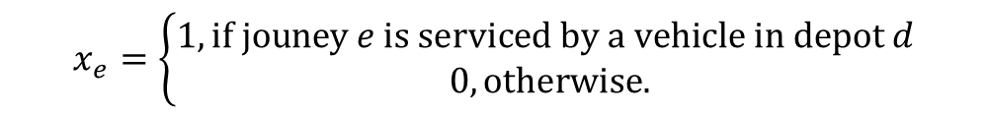
Connection-based network
$$min\sum_{e∈E}{c_{e}x_{e}}$$
$$\text{s}\text{.}\text{t}\text{.}$$
$$\sum_{d∈D_{t}, e=\left(dt\left(t\right), at\left(t\right)\right)}{x_{e}^{d}}=1,∀t∈T$$
$$\sum_{e∈δ^{+}\left(n\right)}{x_{e}^{d}}−\sum_{e∈δ^{−}\left(n\right)}{x_{e}^{d}}=0,∀d∈D, ∀n∈N,$$
$$x_{at\left(d\right), dt\left(d\right)}^{d}≤k_{d},∀d∈D,$$
$$x_{e}^{d}∈\{0,1\},\left(el\left(d\right), sl\left(d\right)\right)≥0 integer,∀d∈D.$$
$$x_{e}=\left\{\begin{aligned}1, if jouney e is serviced by a vehicle in depot d \\ 0, otherwise.\end{aligned}\right.$$

Slide 25
Multi-depot or multi-vehicle type VSP?
Multi-depot: homogeneous fleet, but different starting/ending locations (garages)
Cost function difference in pull-in/pull-out
Multi-vehicle type: heterogeneous fleet, but can start at the same location
Cost difference comes from vehicle characteristics
Vehicle-trip compatibility
Both are NP-hard
In flow-based formulations, exact same modelling
Depot X Vehicle type: 1 commodity

Slide 26
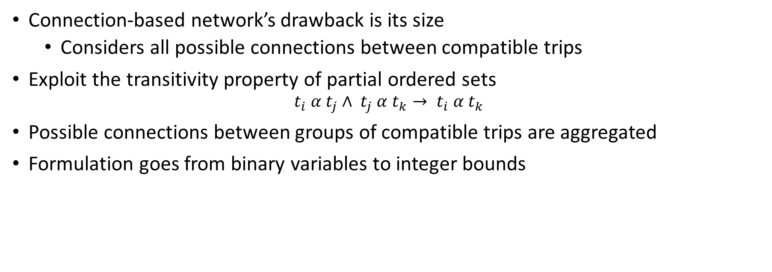
Times-space network (TSN)
Connection-based network’s drawback is its size
Considers all possible connections between compatible trips
Exploit the transitivity property of partial ordered sets
$$t_{i} α t_{j}∧ t_{j} α t_{k}→ t_{i} α t_{k}$$
Possible connections between groups of compatible trips are aggregated
Formulation goes from binary variables to integer bounds
Kliewer, N., Mellouli, T., & Suhl, L. (2006). A time–space network based exact optimization model for multi-depot bus scheduling. European Journal of Operational Research, 175(3), 1616–1627. https://doi.org/10.1016/j.ejor.2005.02.030

Slide 27



Times-space network
space
time
time
G1
a
G2
G1
b
G1
G1
d
G2
G2
f
G2
G2
c
G1
G1
e
G1
a’
b’
b”
c”
d’
e’
e”
Event nodes for each location (trip starting and ending times)
$$G_{1}$$
$$G_{2}$$
a”
c’
d”
f’
f”
$$D$$

Slide 28
TSN edge aggregation – all possible matches
space
time
Station A
Station B

Slide 29
TSN edge aggregation – first matches
space
time
Station A
Station B

Slide 30
TSN edge aggregation – all possible matches
space
time
Station A
Station B

Slide 31
TSN edge aggregation – first matches
space
time
Station A
Station B

Slide 32
TSN edge aggregation – first matches
space
time
Station A
Station B

Slide 33
TSN edge aggregation – latest first matches
space
time
Station A
Station B

Slide 34
TSN edge aggregation – latest first matches
space
time
Station A
Station B

Slide 35
TSN edge aggregation – latest first matches
space
time
Station A
Station B

Slide 36
Times-space network – flow decomposition
Aggregated edges „bundle” similar vehicles together
Any flow has the same total optimal cost
Structural characteristics can make a difference
Multiple algorithms can be constructed
Station A
Station B
Kliewer, N., Mellouli, T., & Suhl, L. (2006). A time–space network based exact optimization model for multi-depot bus scheduling. European Journal of Operational Research, 175(3), 1616–1627. https://doi.org/10.1016/j.ejor.2005.02.030

Slide 37
A variable fixing heuristic
Find chains of trips to „glue” together
Replace them with a single trip
Can exploit structural properties
Gintner et al. (2005)
Gintner, V., Kliewer, N., & Suhl, L. (2005). Solving large multiple-depot multiple-vehicle-type bus scheduling problems in practice. OR Spectrum, 27(4), 507–523. https://doi.org/10.1007/s00291-005-0207-9
Dávid, B., & Krész, M. (2013). Application oriented variable fixing methods for the multiple depot vehicle scheduling problem. Acta Cybernetica, 21(1), 53–73. https://doi.org/10.14232/actacyb.21.1.2013.5

Slide 38
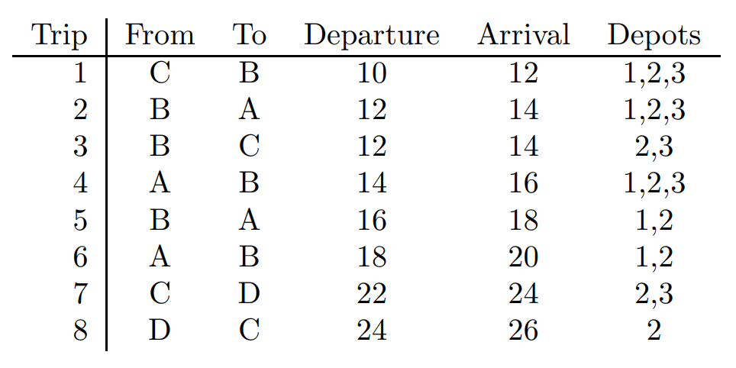
A variable fixing heuristic
A
2
4
5
6
B
1
3
C
7
8
Line A-B: trips 2,4,5,6.
Line B-C: trips 1,3.
Line C-D: trips 7,8.
D
Dávid, B., & Krész, M. (2013). Application oriented variable fixing methods for the multiple depot vehicle scheduling problem. Acta Cybernetica, 21(1), 53–73. https://doi.org/10.14232/actacyb.21.1.2013.5

Slide 39
Maintenance and overnight parking

Slide 40
Maintenance and overnight parking
Longer planning period (several days/weeks/months)
Similar days have the same daily schedule
The same duty on similar days can be executed by different vehicles
Can we assign vehicles to every daily duty?
Given:
Days of the planning period
Theoretical schedules for every day-type
Vehicles
Questions:
Is there a feasible assignment?
Can we consider vehicle needs?
(eg. daily parking, maintenance)
Dávid, B., & Krész, M. (2018). Multi-depot bus schedule assignment with parking and maintenance constraints for intercity transportation over a planning period. Transportation Letters, 12(1), 66–75. https://doi.org/10.1080/19427867.2018.1512216

Slide 41


Maintenance and overnight parking
start of the
planning period
schedule of
day 1
end of
day 1
schedule of
day 2
end of the
planning period

Slide 42


Maintenance and overnight parking – state expansion
More states…
State 1
State 0

Slide 43
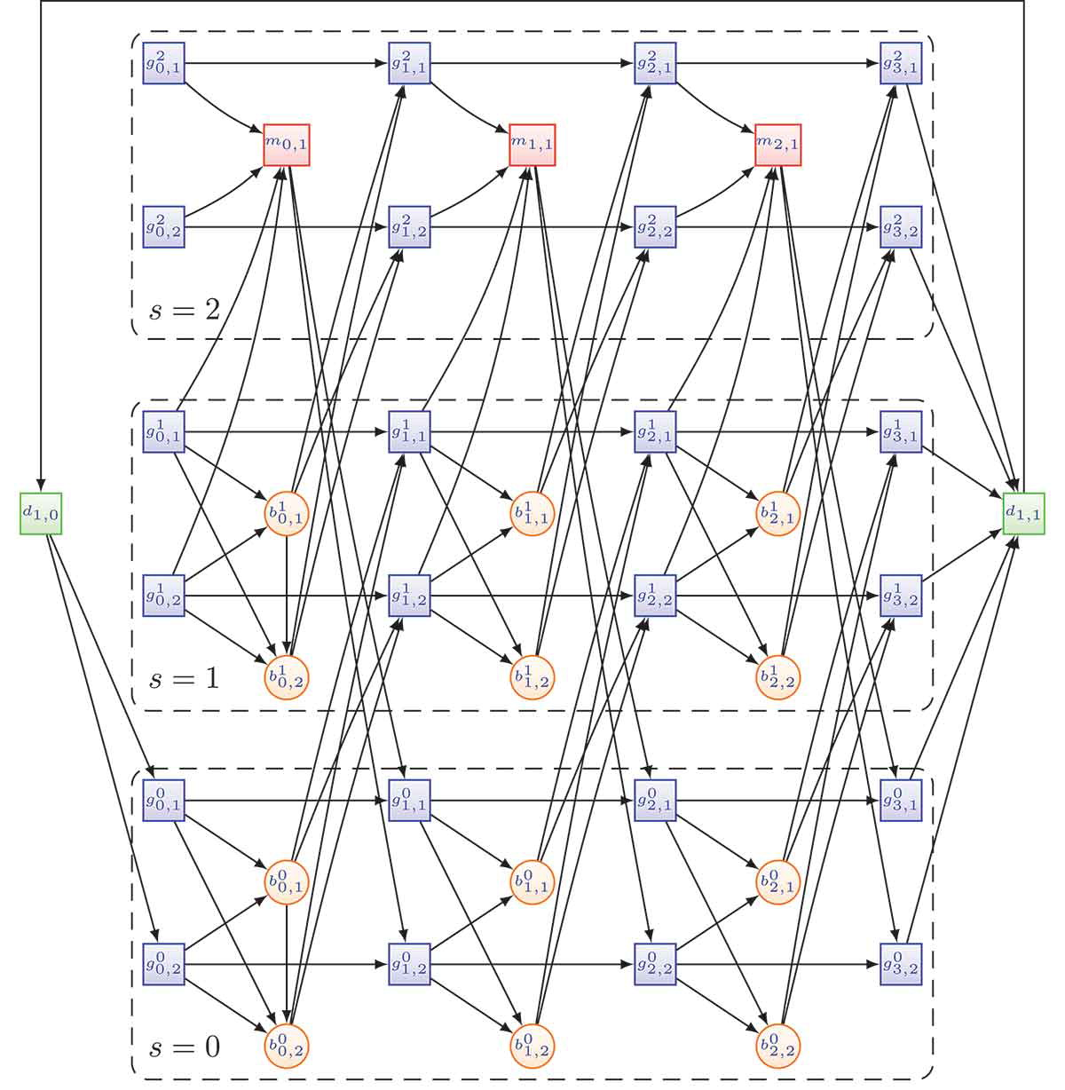
Maintenance and overnight parking

Slide 44
Maintenance and overnight parking
s₂
s₂
s₂
s₁
s₁
s₁
s₀
s₀
s₀
s₂
s₂
s₂
s₁
s₁
s₁
s₀
s₀
s₀

Slide 45
Regularity of schedules

Slide 46
Regularity of schedules
Solving the VSP independently results in irregular schedules
Optimal cost
Significantly different from other schedules
Regularity is important
Similar day-types should have similar schedules
Operational costs are not optimal
Better solution regarding the drivers’ „cost-function”
Regularity in the literature
Airline crew
Tajima and Misono (1997), Klabjan et al. (2001)
Bus transportation
Steinzen et al. (2009) – crew
Amberg et al. (2011)
Dávid, B., & Krész, M. (2018). A robust approach for creating similar vehicle schedules in practice. In Proceedings of the 12th International Conference on the Practice and Theory of Automated Timetabling (PATAT 2018) (pp. 487–488). TU Wien.

Slide 47
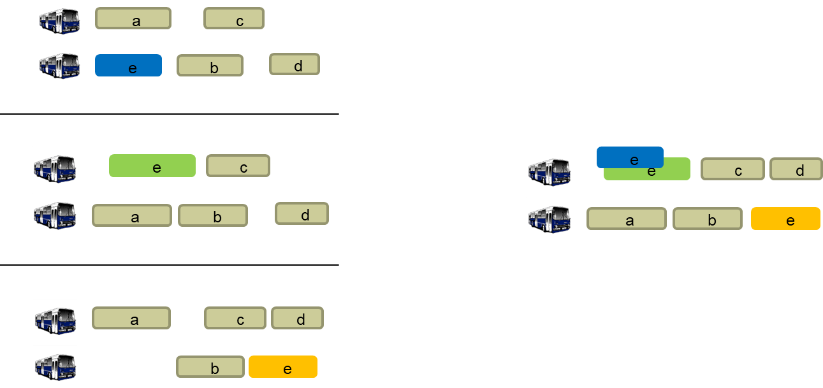
Regularity of schedules

Slide 48
Regularity of schedules
Main approaches
Modification
Patterns
Modifications
Uses a reference schedule
What to choose?
Regularity patterns
Fix some part of the problem
Amberg et al. (2011)
Short examples for rescheduling and regularity
Mathematical model
simultaneous resource scheduling problem with irregular tasks and regular patterns
Flow decomposition techniques

Slide 49
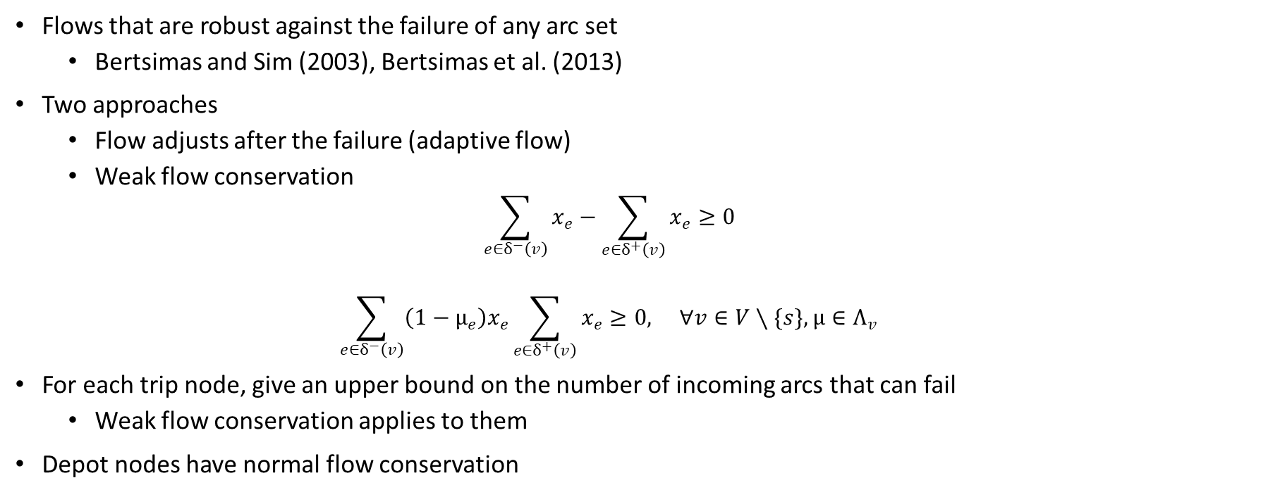
Regularity of schedules
Flows that are robust against the failure of any arc set
Bertsimas and Sim (2003), Bertsimas et al. (2013)
Two approaches
Flow adjusts after the failure (adaptive flow)
Weak flow conservation
$$\sum_{e∈δ^{−}\left(v\right)}{x_{e}}−\sum_{e∈δ^{+}\left(v\right)}{x_{e}}≥0$$
$$\sum_{e∈δ^{−}\left(v\right)}{\left(1−μ_{e}\right)x_{e}\sum_{e∈δ^{+}\left(v\right)}{x_{e}}}≥0, ∀v∈V∖\{s\},μ∈Λ_{v}$$
For each trip node, give an upper bound on the number of incoming arcs that can fail
Weak flow conservation applies to them
Depot nodes have normal flow conservation

Slide 50

Regularity of schedules
e
e
c
d
a
b
e
e
c
d
e
b
e
a

Slide 51
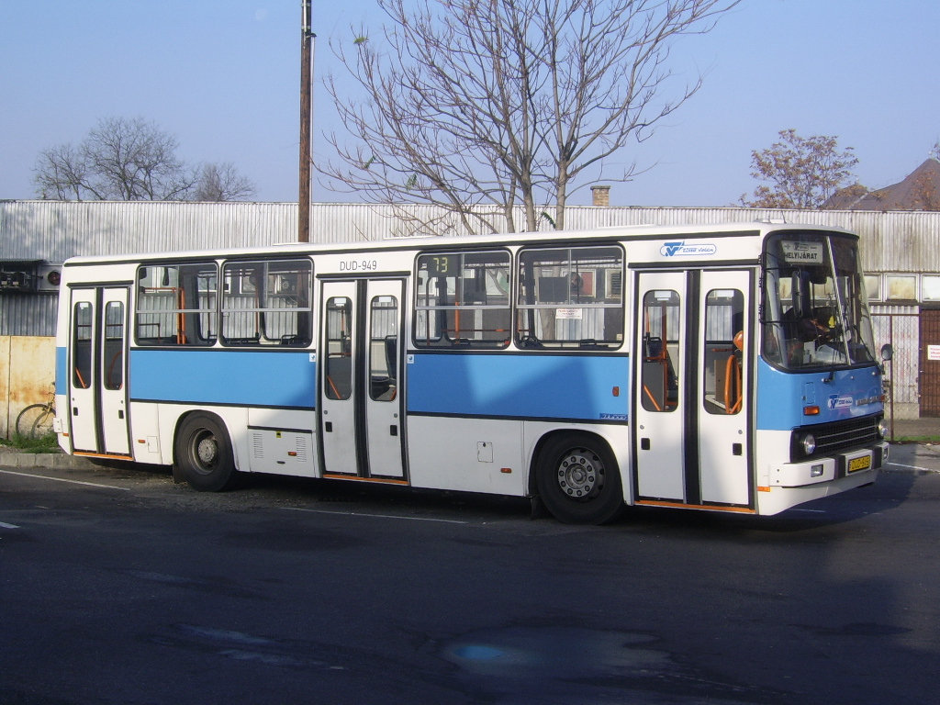
Conclusions
A small glimpse at some public transport questions
Real-world relevance, hard to solve
So many questions left unanswered…
source: https://commons.wikimedia.org/wiki/File:Busz_Szeged_Tisza_Volan_2.JPG

Slide 52

Thank you for your time!

Slide 53
References
Ibarra-Rojas, O. J., Delgado, F., Giesen, R., & Muñoz, J. C. (2015). Planning, operation, and control of bus transport systems: A literature review. Transportation Research Part B: Methodological, 77, 38–75. https://doi.org/10.1016/j.trb.2015.03.002
Saha, J. L. (1970). An algorithm for bus scheduling problems. Operational Research Quarterly, 21(4), 463–474. https://doi.org/10.2307/3008423
Orloff, C. S. (1976). Route constrained fleet scheduling. Transportation Science, 10(2), 149–168. https://doi.org/10.1287/trsc.10.2.149
Bertossi, A. A., Carraresi, P., & Gallo, G. (1987). On some matching problems arising in vehicle scheduling models. Networks, 17(3), 271–281. https://doi.org/10.1002/net.3230170303
Kliewer, N., Mellouli, T., & Suhl, L. (2006). A time–space network based exact optimization model for multi-depot bus scheduling. European Journal of Operational Research, 175(3), 1616–1627. https://doi.org/10.1016/j.ejor.2005.02.030
Gintner, V., Kliewer, N., & Suhl, L. (2005). Solving large multiple-depot multiple-vehicle-type bus scheduling problems in practice. OR Spectrum, 27(4), 507–523. https://doi.org/10.1007/s00291-005-0207-9
Dávid, B., & Krész, M. (2013). Application oriented variable fixing methods for the multiple depot vehicle scheduling problem. Acta Cybernetica, 21(1), 53–73. https://doi.org/10.14232/actacyb.21.1.2013.5
Dávid, B., & Krész, M. (2018). Multi-depot bus schedule assignment with parking and maintenance constraints for intercity transportation over a planning period. Transportation Letters, 12(1), 66–75. https://doi.org/10.1080/19427867.2018.1512216
Dávid, B., & Krész, M. (2018). A robust approach for creating similar vehicle schedules in practice. In Proceedings of the 12th International Conference on the Practice and Theory of Automated Timetabling (PATAT 2018) (pp. 487–488). TU Wien.
Tajima, A., & Misono, S. (1997). Airline crew-scheduling problem with many irregular flights. In H. W. Leong, H. Imai, & S. Jain (Eds.), Algorithms and Computation. ISAAC 1997. Lecture Notes in Computer Science (Vol. 1350, pp. 2–11). Springer. https://doi.org/10.1007/3-540-63890-3_2

Slide 54
References
Diego Klabjan, Ellis L. Johnson, George L. Nemhauser, Eric Gelman, Srini Ramaswamy, (2001) Airline Crew Scheduling with Regularity. Transportation Science 35(4):359-374. https://doi.org/10.1287/trsc.35.4.359.10437
Steinzen, I., Suhl, L. & Kliewer, N. Branching strategies to improve regularity of crew schedules in ex-urban public transit. OR Spectrum 31, 727–743 (2009). https://doi.org/10.1007/s00291-008-0136-5
Amberg, B., Amberg, B., & Kliewer, N. (2011). Approaches for increasing the similarity of resource schedules in public transport. Procedia — Social and Behavioral Sciences, 20, 836–845. https://doi.org/10.1016/j.sbspro.2011.08.075
Bertsimas, D., Sim, M. Robust discrete optimization and network flows. Math. Program., Ser. B 98, 49–71 (2003). https://doi.org/10.1007/s10107-003-0396-4
Bertsimas, D., Nasrabadi, E., & Stiller, S. (2013). Robust and Adaptive Network Flows. Operations Research, 61(5), 1218–1242. http://www.jstor.org/stable/24540495

